Slide 1

Credit Card Customer Segmentation

Slide 2

INTRODUCTION
"Credit cards aren't banking - they're information"
--- Richard Fairbank, Founder of Capital One
Customer segmentation is one of the most fundamental building blocks in getting to know customers. It is essential for industries where customer interaction is frequent and varied, as each interaction provides insight into opportunities and risks for every individual. The credit card industry is on par with telecommunications, e-commerce, and retail from this perspective, and the industry gains significant ROI from segmentation initiatives. Surprisingly, all around the world, there are many banks still not taking advantage of this opportunity, frequently due to a lack of tools or in-house resources to process and digest big data sources, sitting on top of a gold mine that erodes each day when left untouched.

Slide 3

BACKGROUND STUDY
Bank wants to focus on its credit card customer base in the next financial year. They have been advised by their marketing research team, that the penetration in the market can be improved. Based on this input, the Marketing team proposes to run personalised campaigns to target new customers as well as upsell to existing customers. Another insight from the market research was that the customers perceive the support services of the back poorly. Based on this, the Operations team wants to upgrade the service delivery model, to ensure that customers queries are resolved faster. Head of Marketing and Head of Delivery both decide to reach out to the Data Science team for help.

Slide 4

PROBLEM STATEMENT
To identify different segments in the existing customer based on their spending patterns as well as past interaction with the bank.

Slide 5
KEY QUESTIONS
How many different segments of customers are there?
How are these segments different from each other?
What are your recommendations to the bank on how to better market to and service these customers?

Slide 6
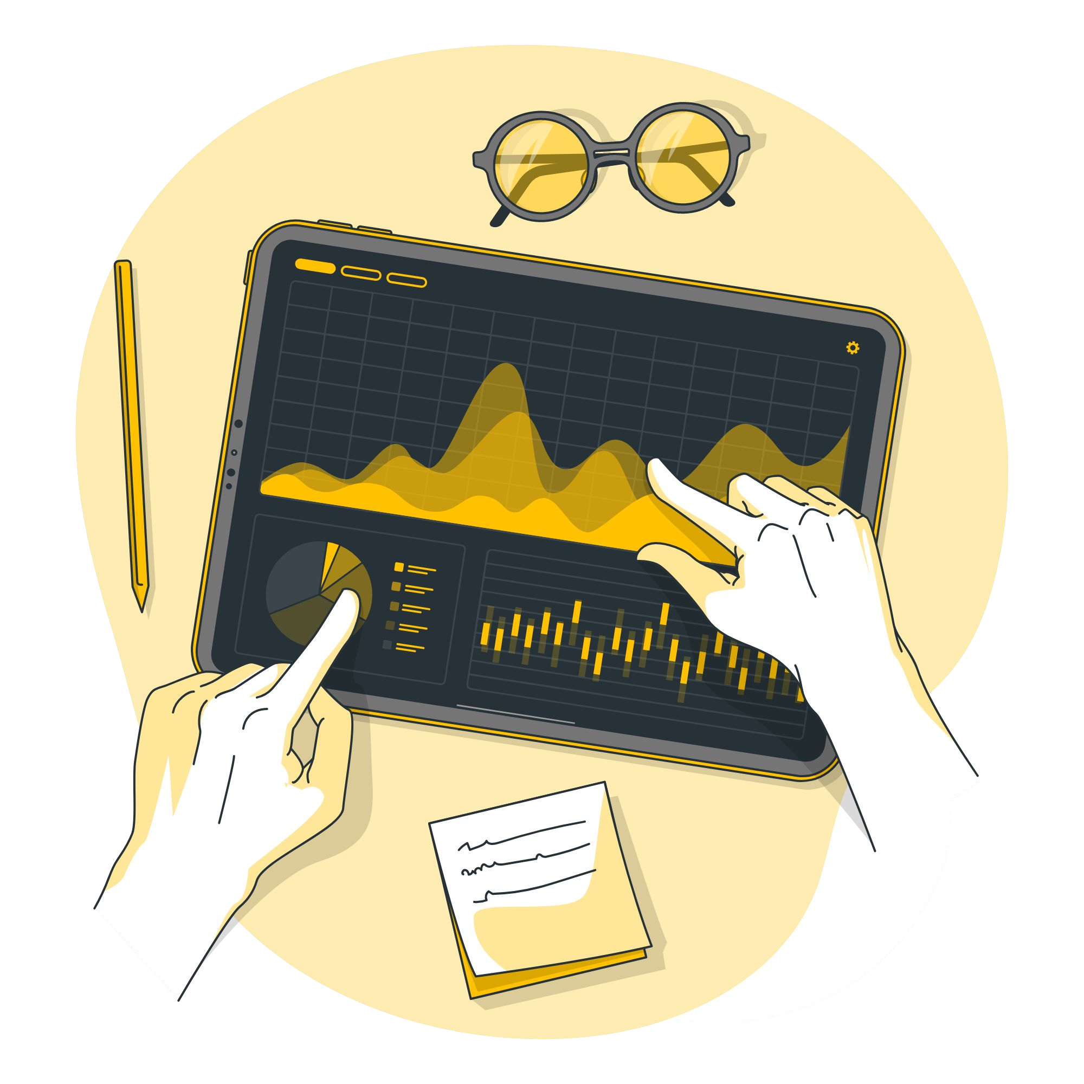
SOLUTION APPROACH
Step 1: Identified different customer segments by applying KMeans, different Hierarchical clustering techniques
Step 2: Choosing value of K (no. of clusters) using elbow, silhouette diagram, silhouette scores
Step 3: Hierarchical clustering using SciPy Linkage and calculating cophenetic correlation to see how better are clusters
Step 4: Interesting observations are made during EDA and it is proved after doing clustering
Step 5: Used PCA in order to reduce dimensionality

Slide 7

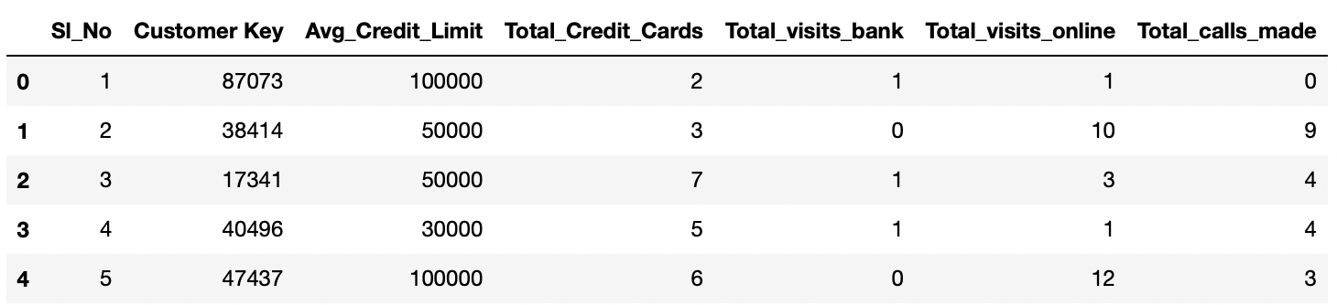
DATASET
The data we have used in this project was Kaggle dataset. The dataset consists of 660 rows and 7 columns with no null values. Data is of various customers of a bank with their credit limit, the total number of credit cards the customer has, and different channels through which customer has contacted the bank for any queries, different channels include visiting the bank, online and through a call centre.

Slide 8
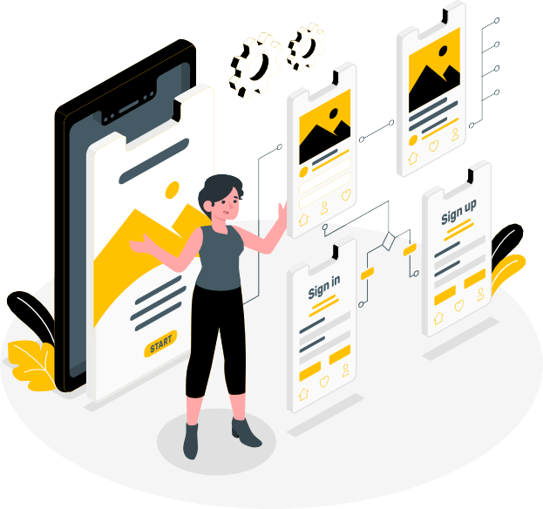
DATASET OBSERVATION
Sl_No and Customer_Key can be dropped as it is not needed for model training
There is no target variable here. So, we need to build an unsupervised learning model
Credit limit has higher magnitude compared to other columns. We need to scale the features. Ignore SL_No and Customer Key columns
Here zeros are valid values (ie., customer did not use that specific mode of communication.) and not missing values
"Avg_Credit_Limit" ranges from 3K to 200K with an avg of 34.5K but 50% of customers have less than 18K. So it is heavily right skewed. It has a Std Deviation of 34K

Slide 9
DATASET OBSERVATION
"Total_Credit_Cards" ranges from 1 to 10 cards with an avg of ~5 and also 50% of customers have less than 5. It has a Std Deviation of ~5
"Total_visits_bank" ranges from 0 to 5 times with an avg of ~2 and also 50% of customers have less than 2. It has a Std Deviation of ~2
"Total_visits_online" ranges from 0 to 15 times with an avg of ~3 and also 50% of customers have less than 2. 75% of customers in the dataset have online visits less than 4. So it is heavily right skewed. It has a Std Deviation of ~3
"Total_calls_made" ranges from 0 to 10 times with an avg of ~4 and also 50% of customers have less than 3. Little bit right skewed. It has a Std Deviation of ~3

Slide 10
FEATURE ENGINEERING
Out of 660 rows of customers:
there are 110 distinct abg credit limits
There are 10 distinct total credit cards.
more number of customers below 10K avg credit limit
22% of customers have 4 credit cards and ~3% with 10 credit cards
24% of customer visited bank twice and 15% of customers never visited bank. 85% visited atleast once
~22% of customer never did online banking. 78% of customers visited online banking atleast once
~15% of customers never called bank. 85% of customers called at least once

Slide 11
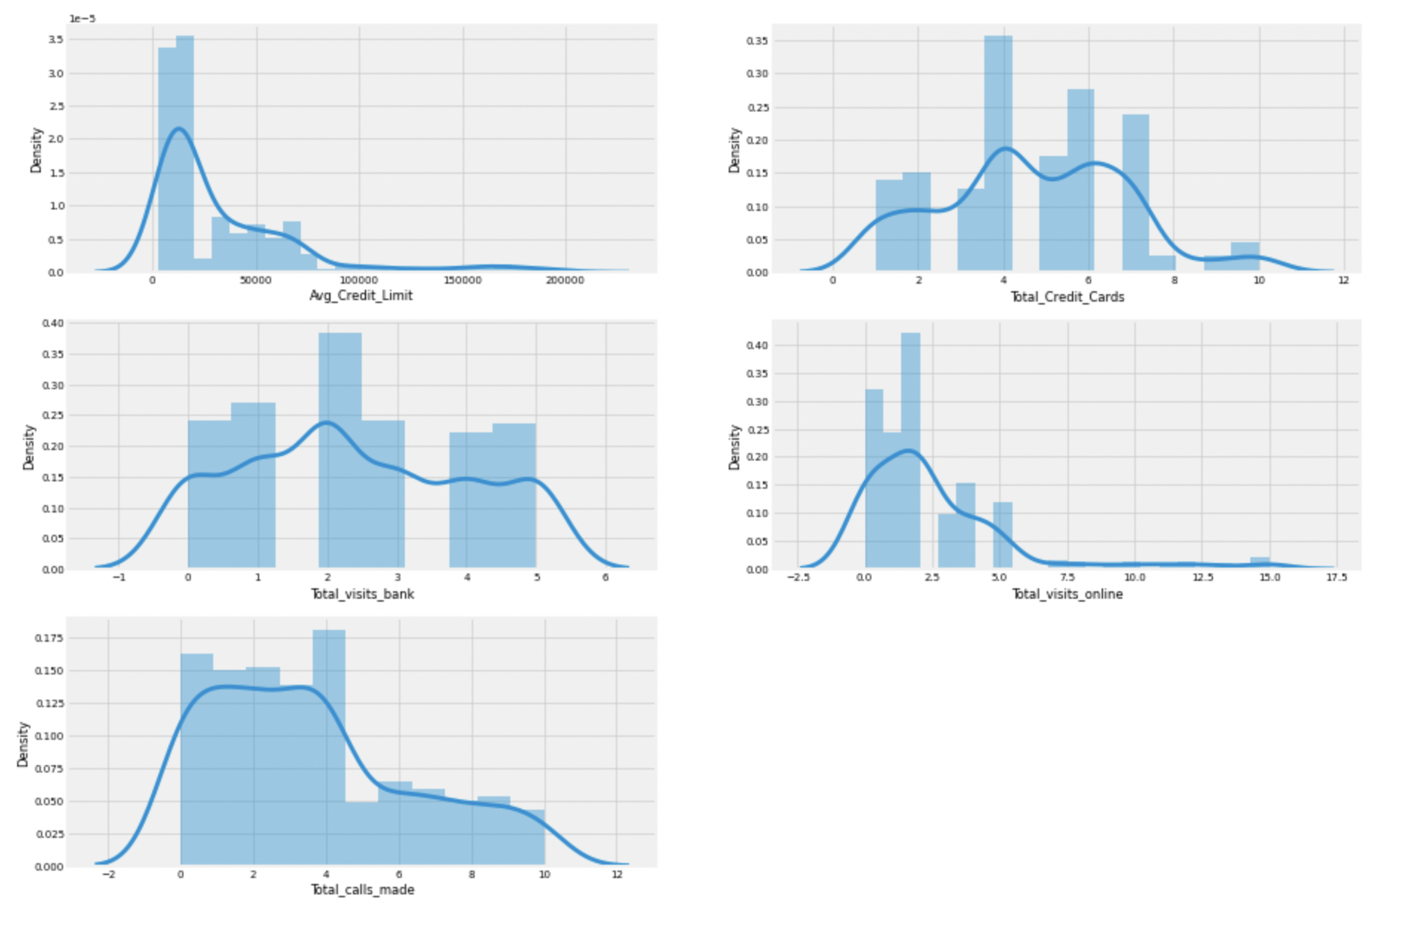

ANALYZING CUSTOMERS USING DIFFERENT MODES OF COMMUNICATION
Notes:
Observation
Avg Credit limit is heavily right skewed
credit cards, visits online, total calls have multiple peaks
majority of customers have 4 credit cards
majority of customers visited bank twice
majority of customers visited bank online is twice
majority of customers made <=4 calls to the bank

Slide 12
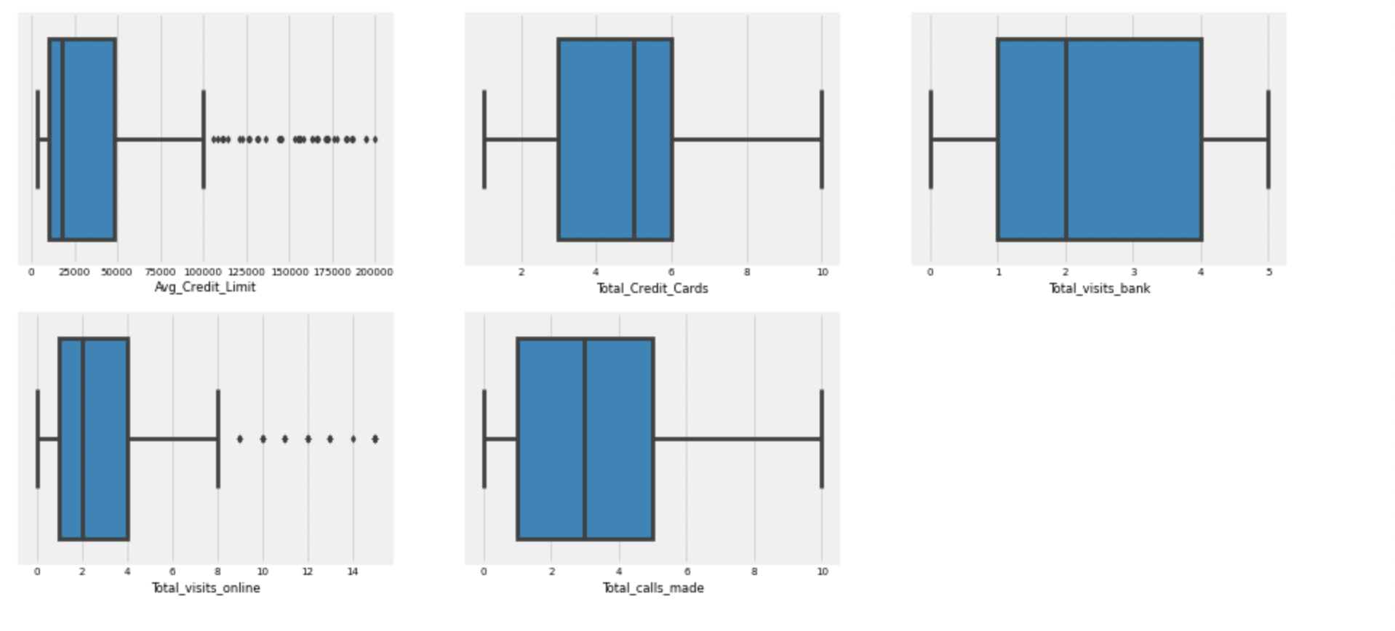
ANALYZING CUSTOMERS USING DIFFERENT MODES OF COMMUNICATION
Notes:
Observation
Avg Credit limit has lot of outliers
visits online also has outliers

Slide 13
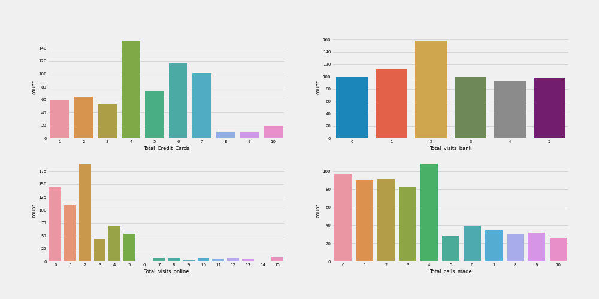
ANALYZING CUSTOMERS USING DIFFERENT MODES OF COMMUNICATION
Notes:
Observation
Majority of customers have 4 credit cards and then 6 and 7 credit cards. Very few have >=8 cards
~160 customers visited bank twice
majority of customers visited bank online is twice and majority of visits by most of the customers are <=5
majority of customers made <=4 calls to the bank

Slide 14

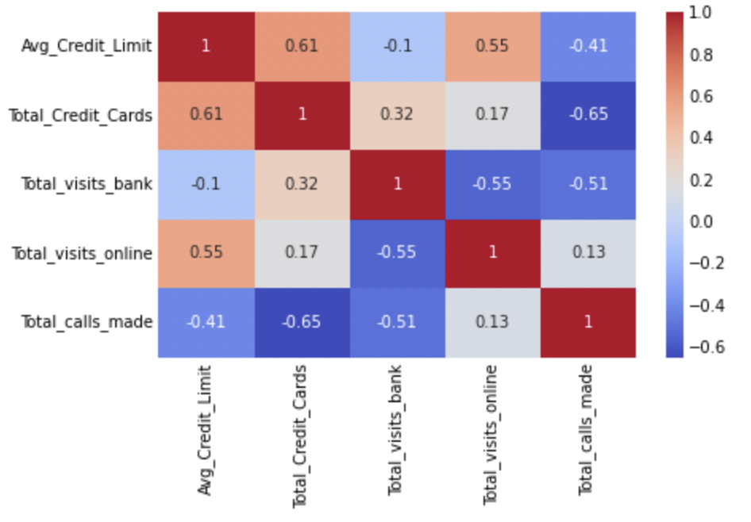
ANALYZING CUSTOMERS USING DIFFERENT MODES OF COMMUNICATION
Notes:
observation
+ve correlation (0.61) between credit limit and no. of cards
+ve correlation (0.55) between credit limit and visits online
-ve correlation (-0.41) between credit limit and calls made
-ve correlation (-0.65) between calls made and total credit cards
-ve correlation (-0.55) between online visits and bank visits
-ve correlation (-0.51) between calls made and vists to bank

Slide 15
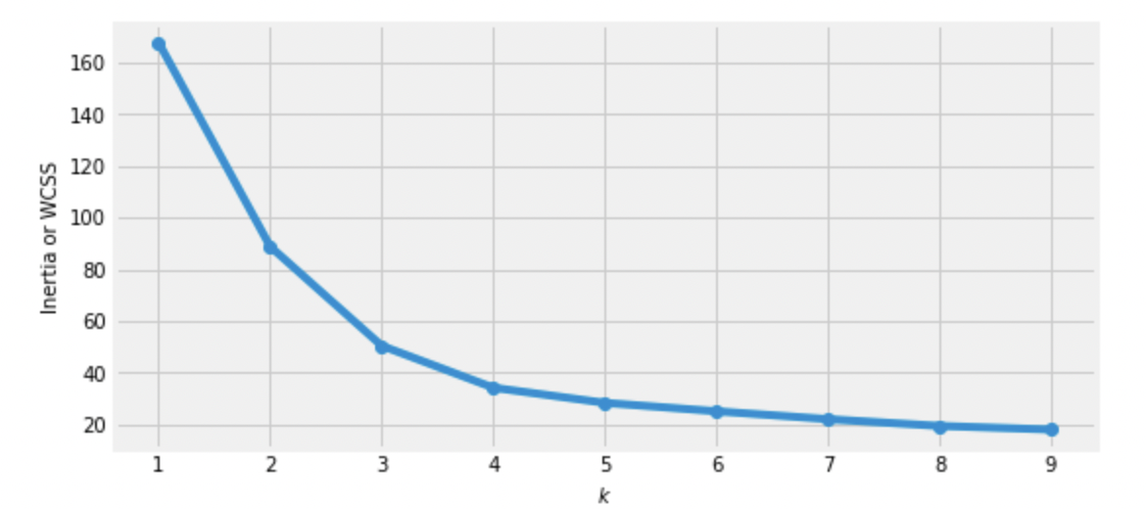
MODEL BUILDING : K-MEANS CLUSTERING
Elbow method to find optimal no. of clusters
Notes:
Observation
From the above graph of "Elbow Method", we can find the possible number of clusters. From the graph, we can see the elbow bend at 3.
we can choose K=3 or K=4
At k=3 we have an inertia of 50.42 and at K=4 we have 34.23
Will decide K based on Silhouette score

Slide 16
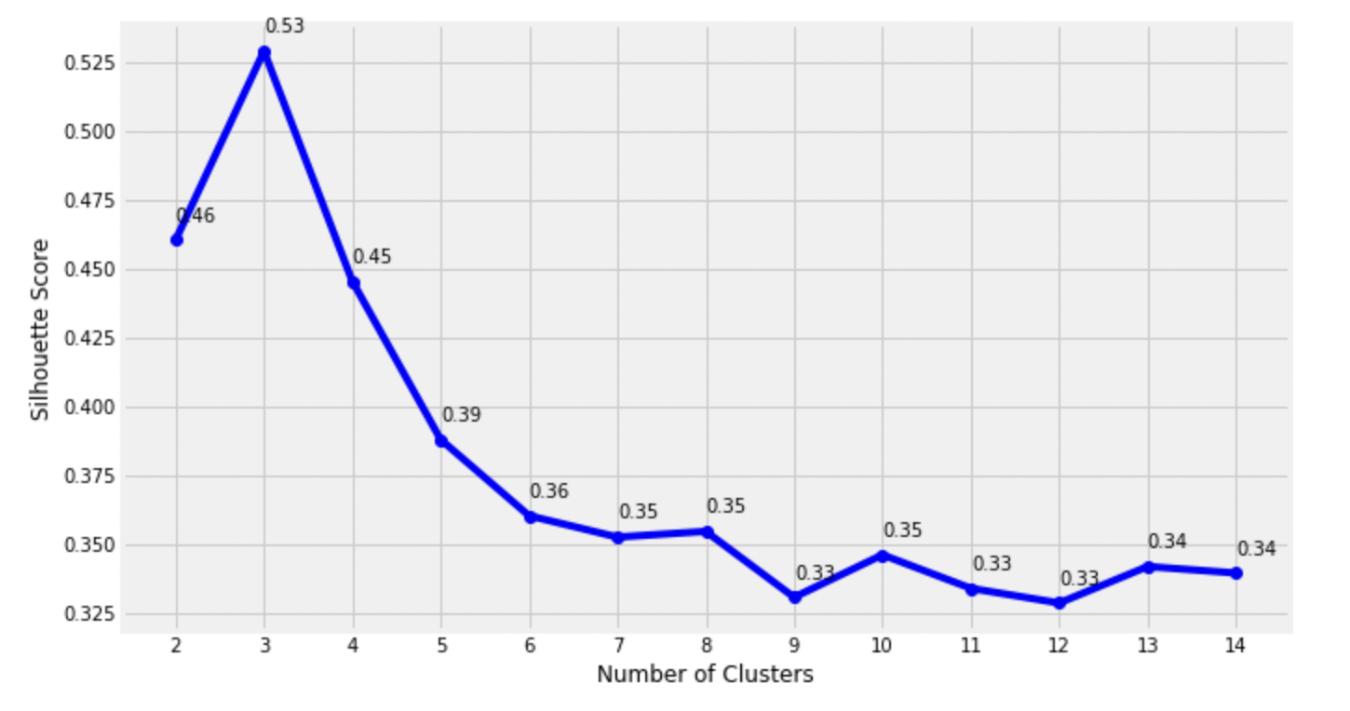
MODEL BUILDING : K-MEANS CLUSTERING
Sillhouette Scores multiple
Notes:
Observation
This visualization is much richer than the previous one: although it confirms that k = 3 is a very good choice, it also underlines the fact that k = 4 is not that good, and much better than k = 6,7, 8,9... This was not visible when comparing inertias.
At K=3, we have a Sil.Score of 0.53.
We will take K=3

Slide 17
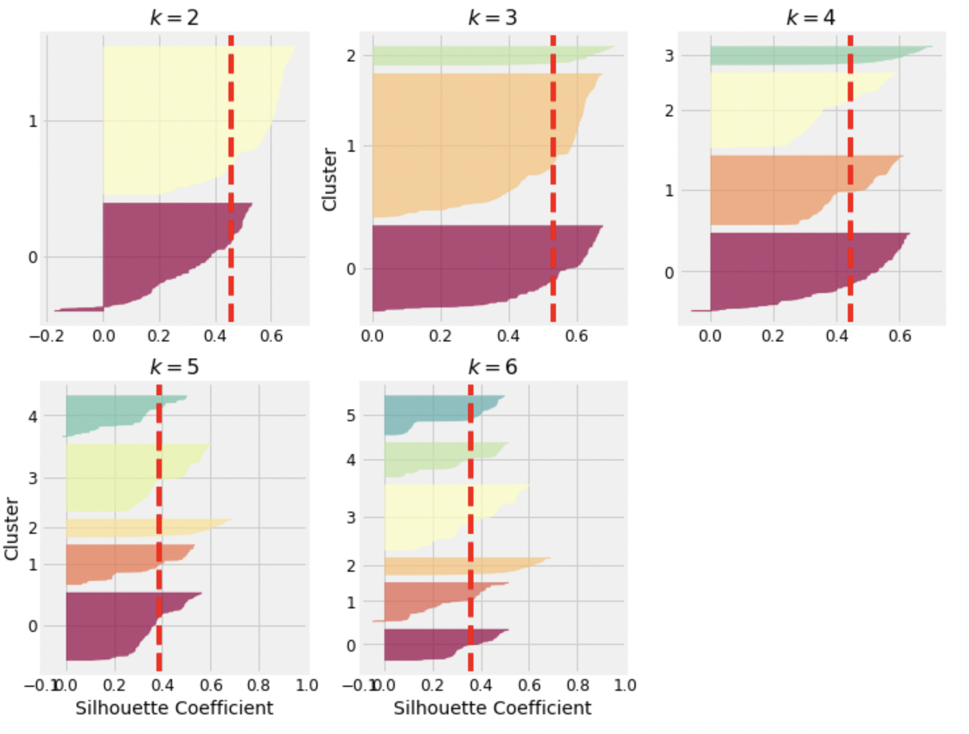
MODEL BUILDING : K-MEANS CLUSTERING
Analyzing the silhouette diagrams for various values of k
Notes:
Observation
The vertical dashed lines represent the silhouette score for each number of clusters. When most of the instances in a cluster have a lower coefficient than this score (i.e., if many of the instances stop short of the dashed line, ending to the left of it), then the cluster is rather bad since this means its instances are much too close to other clusters.
when k = 3, the clusters look good: most instances extend beyond the dashed line, to the right and closer to 1.0

Slide 18
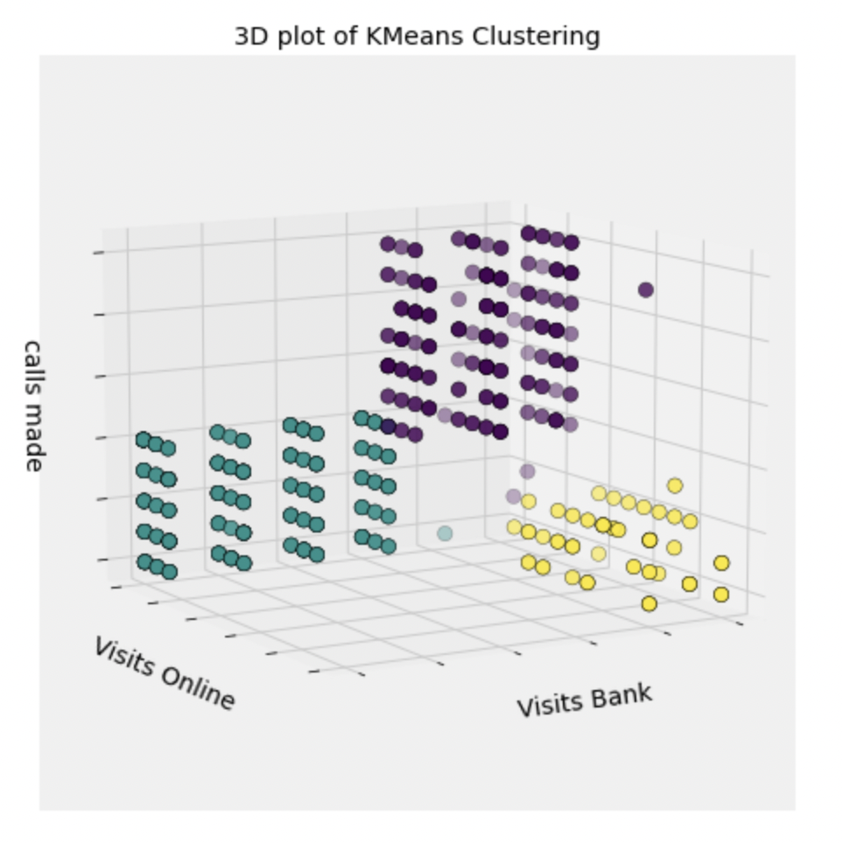
MODEL BUILDING : K-MEANS CLUSTERING
Notes:
Observation
Cluster 2 has ~58% of total customers
Cluster 1 with ~35% of total customers
Cluster 0 with ~8% of total customers

Slide 19
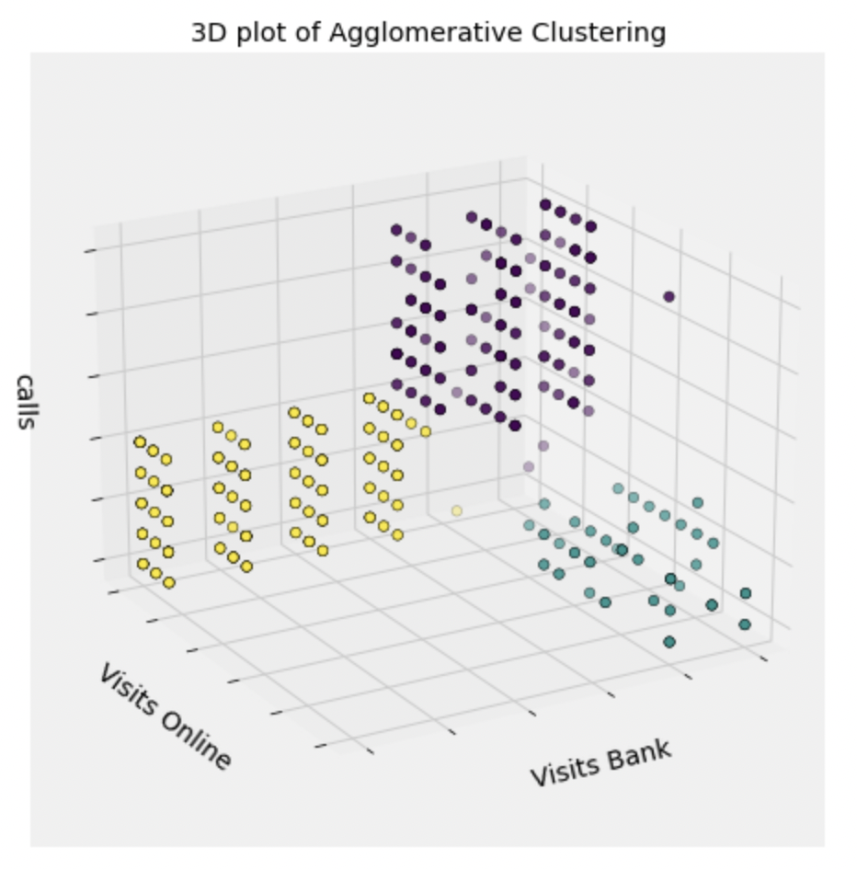
Model Building : Agglomerative Clustering
Notes:
Observation on Clusters created by Agg CLustering
Cluster Analysis:
Cluster 0: Customers with lower Total credit limit (fewer credit cards),more calls to bank, medium bank visits, medium online visits
Cluster 1: It includes cutomers with higher Total credit limit (higher number of credit cards), fewer calls made to bank, less bank visits and highest online visits
Cluster 2: Customers with medium credit limit (medium number of credit cards), few calls made, more bank visits and very less online visits

Slide 20
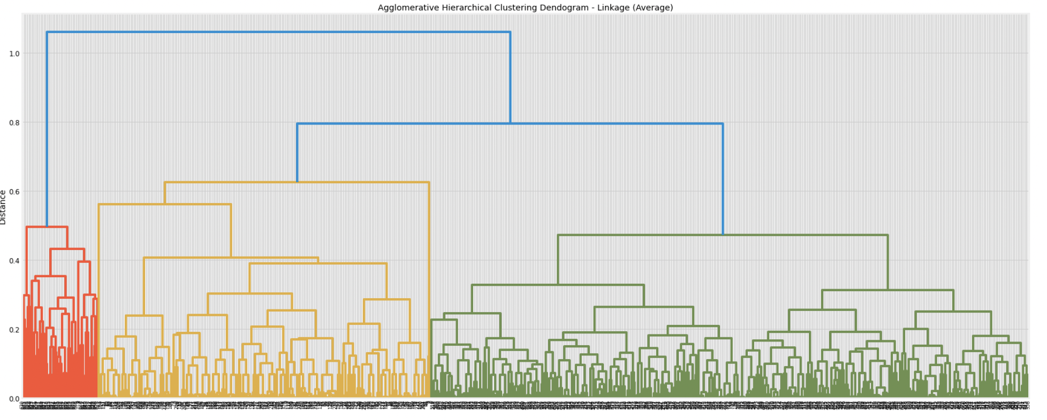
MODEL BUILDING: HIERACHICIAL CLUSTERING

Slide 21
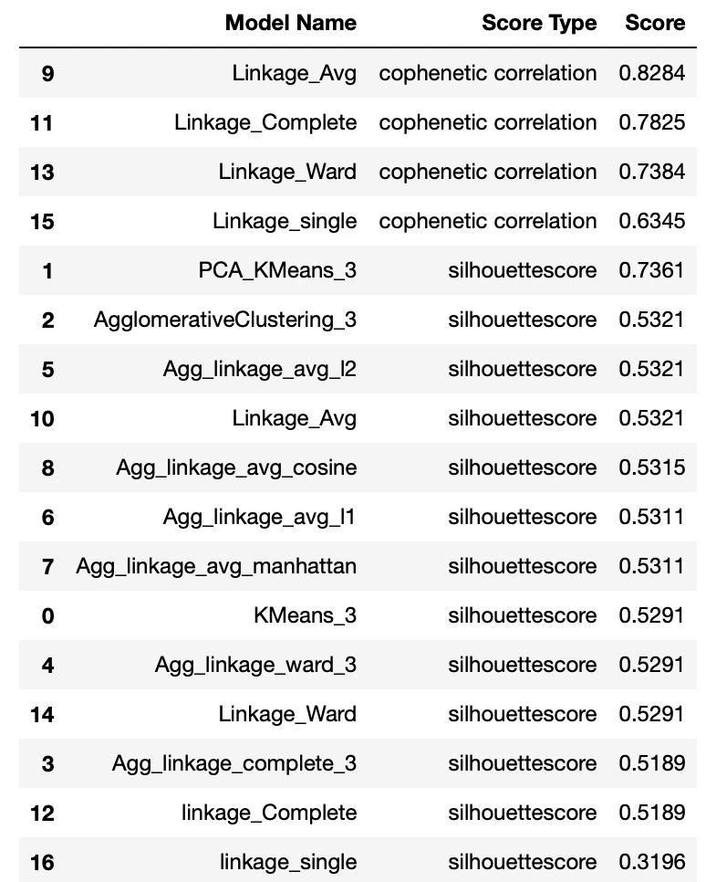
MODELS' COMPARISON
Notes:
Observation
Linkage_Avg has highest CC of ~0.82 compared to other scipy linkage models
wrt Silhouette scores -> Agg Clustering with euclidean and Avg, L2 with avg, Scipy Linkage Avg have same scores of 0.53
KMeans on PCA reduced data has the highest Sil. Score of ~0.74 out performing other models
Linkage Single (from sklearn or scipy) is the bad model because it has least CC and least SS

Slide 22
KEY QUESTIONS : ANSWERS
These segments mainly differ based on credit limits as below.
1) High Credit Limit preference of online bank
2) Medium Credit Limit preference of bank visits
3) Low Credit Limit preference of calling bank
Customers who have high credit limit seems to be high spenders with more number of credit cards and they prefer to bank online rather visiting the bank or calling bank
Customers who have low credit limit have less number of credit cards and have more calls made to the bank
Customers with medium credit limit have more credit cards when compared to low credit customers and have less calls made to bank as compared to low credit customers but have more visits to bank overall
We can tailor contact methods to these customer preferences. Online/phone users will probably prefer email/text notifications, while in-person users mail prefer mail notifications and upselling (when at the bank location). Since online users tend to have (and presumably use) the most credit, these may be the demographic we want to target with our next ad campaign
Notes:
Key Questions:
How many different segments of customers are there?
How are these segments different from each other?
What are your recommendations to the bank on how to better market to and service these customers?

Slide 23

RECOMMENDATIONS TO BANK:
Whereas customers with comparatively low credit limit make visits to bank more often, hence they can either be prompted with benefits of online banking or can be catered with in-bank offers/services and flyers
Customers with low credit limits have less frequency on online platform, they can be marketed with benefits of online banking and/or make customer call center reps aware of promotions and offers so that they can target this segment of customers
Based on how bank wants to promote its products and services, a segment of customers can be targeted as we know their prefered mode of commmunication with bank

Slide 24
RECOMMENDATIONS TO BANK
As we see there are three (3) categories/segments of customers with each segment having a preference for communication channel with bank, it is recommended that products are marketed to specific segment of customers through their preferred channel. Also, additional services can be provided based on how they connect with bank and also based on their spending pattern which can deduced from average credit limit.
Customers with high credit limit tend to vist online. Hence they can be targeted for online campaigns, coupons and accordingly products and services can be offered to them

Slide 25




THANK YOU!
“Predicting the future isn’t magic It’s Artiﬁcial Intelligence.”
~Dave Waters
CREDITS: This presentation template was created by Slidesgo, including icons by Flaticon, and infographics & images by Freepik and illustrations by Stories

